Slide 1
Section 5

Slide 2
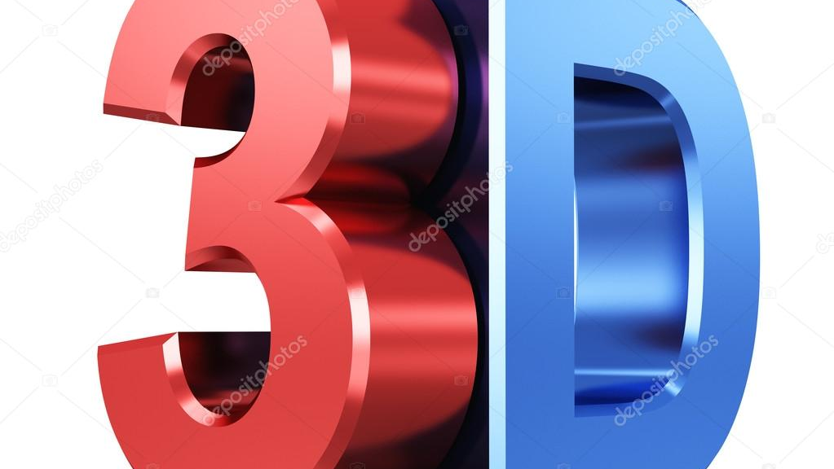
3D Environment

Slide 3
Orthographic Projection vs. Perspective Projection
Orthographic
Perspective
:Simply, it ignores the z-component of the point. Good for engineering designs but not realistic because if objects far from the eye should appear smaller than objects close the eye. However, this doesn't happen in orthographic projection
Things far from the eye look smaller. It tries to model the viewing of the human eye: First, a ray from the point to the eye is drawn, and its projection on the near plane is observed. The projection on the near plane is what we see on the screen.

Slide 4
Set UP 3D
void SetTransformations() { //set up the logical coordinate system of the window: [-100, 100] x [-100, 100] glMatrixMode(GL_PROJECTION); glLoadIdentity(); gluPerspective(60,(double)800/ 600, 0.01, 1000); glEnable(GL_DEPTH_TEST); // set the camera here gluLookAt( //cam pos 30, 40, 20, //looking at 0, 0, 0, //up dir 0, 1, 0); }

Slide 5
Set UP 3D
fovy
Specifies the field of view angle, in degrees, in the y direction.
aspect
Specifies the aspect ratio that determines the field of view in the x direction. The aspect ratio is the ratio of x (width) to y (height).
zNear
Specifies the distance from the viewer to the near clipping plane (always positive).
zFar
Specifies the distance from the viewer to the far clipping plane (always positive).

Slide 6
Prespective
The command gluPerspective() creates a viewing volume of the shape of a frustum, by specifying the angle of the field of view in the y-z plane and the aspect ratio of the width to height (x/y). (For a square portion of the screen, the aspect ratio is 1.0.) These two parameters are enough to determine an untruncated pyramid along the line of sight. You also specify the distance between the viewpoint and the near and far clipping planes, thereby truncating the pyramid. Note that gluPerspective() is limited to creating frustums that are symmetric in both the x- and y-axes along the line of sight, but this is usually what you want.
void gluPerspective( GLdouble fovy,
GLdouble aspect,
GLdouble zNear,
GLdouble zFar);
Notes:
Frustum:المخروط الناقص
Plane:مستوي
Portion:جزء
an untruncated pyramid along the line of sight:هرم غير مقطوع على طول خط البصر

Slide 7
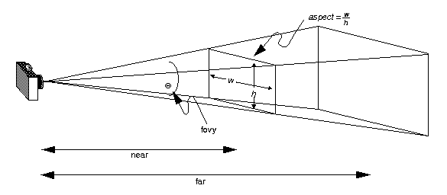
Prespective

Slide 8
glEnable()
The command glEnable() enables a given OpenGL capability, in our case we are enabling the depth buffer. The depth buffer holds the depth of each pixels of the frame. It is also called z buffer.

Slide 9
gluLookAt()
The command gluLookAt creates a viewing matrix derived from an eye point, a reference point indicating the center of the scene, and an UP vector.
void gluLookAt( GLdouble eyeX,
GLdouble eyeY,
GLdouble eyeZ,
GLdouble centerX,
GLdouble centerY,
GLdouble centerZ,
GLdouble upX,
GLdouble upY,
GLdouble upZ);
Notes:
derived from :مستمدة من
a reference point :نقطة مرجعية

Slide 10
Example

Slide 11
Lightening

Slide 12
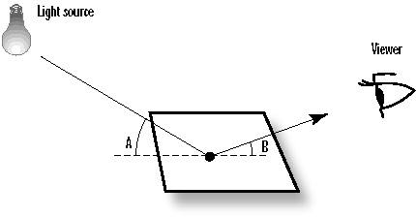
Lightening

Slide 13

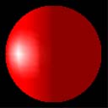
Lightening
To use lighting in OpenGL, you have to:
define one or more light sources, and
specify a material for each primitive drawn that describes how the primitive reflects the incident light

Slide 14
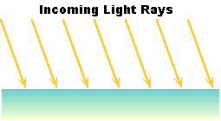
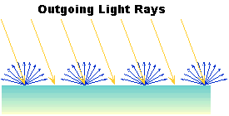
Types of reflectioN
DIFFUSE - An incoming ray of light is reflected uniformly in all directions. So, you see it the same from any view point. However, once the light radiates from the surface, it does so equally in all directions. It is diffuse lighting that best defines the color of 3D objects.
Notes:
منتشرDIFFUSE
radiates :يشع

Slide 15
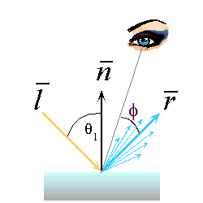
Types of reflectioN
specular – Specular reflection is similar to reflections of light off a shiny, mirror-like surface. Specular lighting helps us to distinguish between flat, dull surfaces such as plaster and shiny surfaces like polished plastics and metals.
Notes:
Specular:براق
like polished plastics and metals:مثل البلاستيك المصقول والمعادن

Slide 16
Types of reflectioN
ambient– Some of the light rays from a light source undergo multiple reflections from various objects in the surroundings and from light sources that populate the environment before hitting and reflecting off the surface of the observed object. But it would be computationally very expensive to model this kind of light precisely. OpenGL approximates this by the ambient light which is a uniform background light existing everywhere in the scene. Similar to diffuse, the light is reflected off the surface uniformly in all directions.
emission – The polygon itself emits additional light regardless of the light sources in the scene.
Notes:
Ambient:محيط ب
خضع:undergo
Emission:انبعاث
Emits:يصدر

Slide 17
light sources in OpenGL
With OpenGL, you can define up to eight light sources, which are referred to through names GL_LIGHT0, GL_LIGHT1, etc. Each source is invested with various properties, and must be enabled. Each property has a default value. to create a source located at (3, 6, 5) in world coordinates, use:
float myLightPosition[4] = {3.0, 6.0, 5.0, 1.0}; glLightfv(GL_LIGHT0, GL_POSITION, myLightPosition); glEnable(GL_LIGHTING); // enable glEnable(GL_LIGHT0); // enable this particular source

Slide 18
light sources in OpenGL
The command used to specify all properties of lights is glLight{if}[v](light, pname, param), where:
Light | refers to the light source being modified. It can be either GL_LIGHT0, GL_LIGHT1, …, or GL_LIGHT7.
Pname | refers to the characteristic of the light being set. It can be any of the named parameters given in table 1.
Param | indicates the values to which the pname characteristic is set. It can be an array of values if you are calling the vector version glLight{if}v (). If you the suffix v is dropped, it should be a single value.

Slide 19
Material Properties
The material properties define how the surface of the primitive reflects the incident light.
All material properties can be set using the command glMaterial{if}[v](face, pname, param), where
Face | can be GL_FRONT, GL_BACK, or GL_FRONT_AND_BACK to indicate which face of the object the material should be applied to. A primitive is front-facing when its vertices appear to the camera in a counter-clockwise order. Otherwise, the primitive is back-facing. OpenGL allows you to put different material to front- and back-facing primitives.
Pname | refers to the particular material property being set.
Param | is the desired values for that property, which is either an array of values (if the vector version is used) or the actual value (if the nonvector version is used). The nonvector version works only for setting GL_SHININESS. The possible values for pname are shown in table 2. Note that GL_AMBIENT_AND_DIFFUSE allows you to set both the ambient and diffuse material colors simultaneously to the same RGBA value.
Notes:
counter-clockwise order:ترتيب عكس اتجاه عقارب الساعة

Slide 20
Example

Slide 21
Texture

Slide 22
Texture
What artists and programmers generally prefer is to use a texture. A texture is a 2D image (even 1D and 3D textures exist) used to add detail to an object; think of a texture as a piece of paper with a nice brick image (for example) on it neatly folded over your 3D house so it looks like your house has a stone exterior. Because we can insert a lot of detail in a single image, we can give the illusion the object is extremely detailed without having to specify extra vertices.

Slide 23
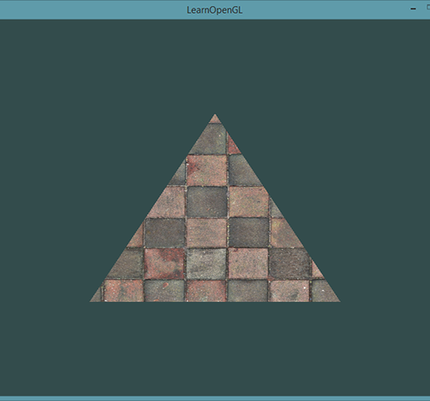
Texture
In order to map a texture to the triangle we need to tell each vertex of the triangle which part of the texture it corresponds to. Each vertex should thus have a texture coordinate associated with them that specifies what part of the texture image to sample from. Fragment interpolation then does the rest for the other fragments.

Slide 24
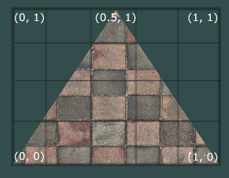
Texture
Texture coordinates range from 0 to 1 in the x and y axis (remember that we use 2D texture images). Retrieving the texture color using texture coordinates is called sampling. Texture coordinates start at (0,0) for the lower left corner of a texture image to (1,1) for the upper right corner of a texture image. The following image shows how we map texture coordinates to the triangle.

Slide 25
Texture Wrapping
The default behavior of OpenGL is to repeat the texture images , but there are more options OpenGL offers:
GL_REPEAT: The default behavior for textures. Repeats the texture image.
GL_MIRRORED_REPEAT: Same as GL_REPEAT but mirrors the image with each repeat.
GL_CLAMP_TO_EDGE: Clamps the coordinates between 0 and 1. The result is that higher coordinates become clamped to the edge, resulting in a stretched edge pattern.
GL_CLAMP_TO_BORDER: Coordinates outside the range are now given a user-specified border color.

Slide 26
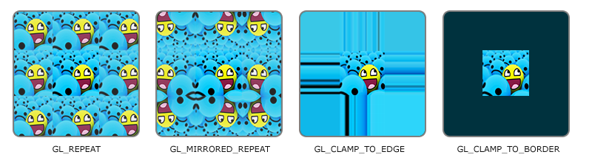
Texture Wrapping
glTexParameteri(GL_TEXTURE_2D, GL_TEXTURE_WRAP_S, GL_MIRRORED_REPEAT); glTexParameteri(GL_TEXTURE_2D, GL_TEXTURE_WRAP_T, GL_MIRRORED_REPEAT);

Slide 27
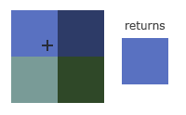
Texture Filtering
OpenGL has options for texture filtering as well. There are several options available but for now we'll discuss the most important options: GL_NEAREST and GL_LINEAR.
GL_NEAREST (also known as nearest neighbor filtering) is the default texture filtering method of OpenGL. When set to GL_NEAREST, OpenGL selects the pixel which center is closest to the texture coordinate. Below you can see 4 pixels where the cross represents the exact texture coordinate. The upper-left texel has its center closest to the texture coordinate and is therefore chosen as the sampled color:

Slide 28
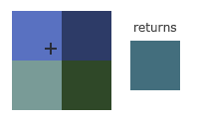
Texture Filtering
GL_LINEAR (also known as (bi)linear filtering) takes an interpolated value from the texture coordinate's neighboring texels, approximating a color between the texels. The smaller the distance from the texture coordinate to a texel's center, the more that texel's color contributes to the sampled color. Below we can see that a mixed color of the neighboring pixels is returned:

Slide 29
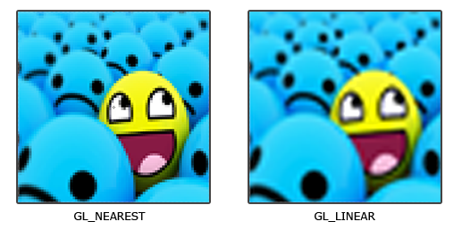
Texture Filtering
glTexParameteri(GL_TEXTURE_2D, GL_TEXTURE_MIN_FILTER, GL_NEAREST); glTexParameteri(GL_TEXTURE_2D, GL_TEXTURE_MAG_FILTER, GL_LINEAR);

Slide 30
Generating a texture
Like any of the previous objects in OpenGL, textures are referenced with an ID; let's create one:
The glGenTextures function first takes as input how many textures we want to generate and stores them in a unsigned int array given as its second argument. Just like other objects we need to bind it so any subsequent texture commands will configure the currently bound texture:
GLuint texture; //The id of the texture
glGenTextures(1, &texture);
glBindTexture(GL_TEXTURE_2D, texture);

Slide 31
Generating a texture
glTexImage2D(GL_TEXTURE_2D, 0, GL_RGB, width, height, 0, GL_RGB, GL_UNSIGNED_BYTE, data); glGenerateMipmap(GL_TEXTURE_2D);

Slide 32
Generating a texture
This is a large function with quite a few parameters so we'll walk through them step-by-step:
The first argument specifies the texture target; setting this to GL_TEXTURE_2D means this operation will generate a texture on the currently bound texture object at the same target.
The second argument specifies the mipmap level for which we want to create a texture for if you want to set each mipmap level manually, but we'll leave it at the base level which is 0.
The third argument tells OpenGL in what kind of format we want to store the texture. Our image has only RGB values so we'll store the texture with RGB values as well.
The 4th and 5th argument sets the width and height of the resulting texture. We stored those earlier when loading the image so we'll use the corresponding variables.
The next argument should always be 0 (some legacy stuff).
The 7th and 8th argument specify the format and datatype of the source image. We loaded the image with RGB values and stored them as chars (bytes) so we'll pass in the corresponding values.
The last argument is the actual image data.

Slide 33
Example
Notes:
https://learnopengl.com/Getting-started/Textures

Slide 34
Collision
Notes:
https://learnopengl.com/Getting-started/Textures

Slide 35
Collision
When trying to determine if a collision occurs between two objects, we generally do not use the data of the objects themselves since these objects are often quite complicated; this in turn also makes the collision detection complicated. For this reason, it is a common practice to use more simple shapes (that usually have a nice mathematical definition) for collision detection that we overlay on top of the original object. We then check for collisions based on these simple shapes which makes the code easier and saves a lot of performance. Several examples of such collision shapes are circles, spheres, rectangles and boxes; these are a lot simpler to work with compared to meshes with hundreds of triangles.

Slide 36
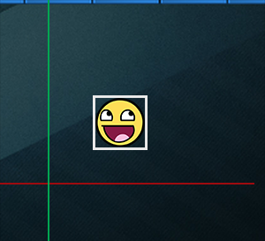
AABB - AABB collisions
AABB stands for axis-aligned bounding box which is a rectangular collision shape aligned to the base axes of the scene, which in 2D aligns to the x and y axis. Being axis-aligned means the rectangular box is not rotated and its edges are parallel to the base axes of the scene (e.g. left and right edge are parallel to the y axis). The fact that these boxes are always aligned to the axes of the scene makes all calculations easier. Here we surround the ball object with an AABB:

Slide 37
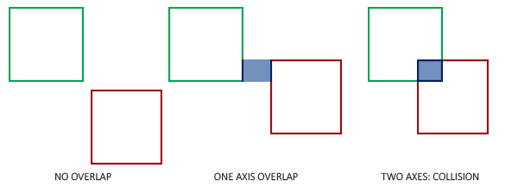
how do we determine collisions?
A collision occurs when two collision shapes enter each other's regions e.g. the shape that determines the first object is in some way inside the shape of the second object. For AABBs this is quite easy to determine due to the fact that they're aligned to the scene's axes: we check for each axis if the two object' edges on that axis overlap. So basically we check if the horizontal edges overlap and if the vertical edges overlap of both objects. If both the horizontal and vertical edges overlap we have a collision.
Notes:
if(player1.x < player2.x + player2.width && player1.x + player1.width > player2.x && player1.y < player2.y + player2.height && player1.y + player1.height > player2.y) {
System.out.println("Collision Detected"); }

Slide 38
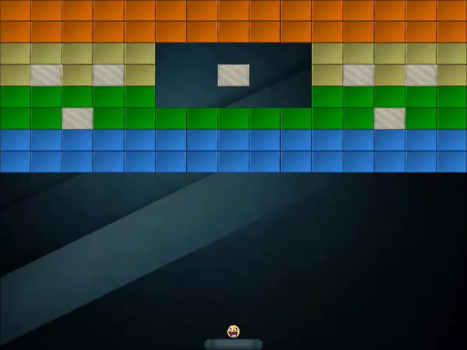
how do we determine collisions?

Slide 39
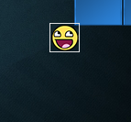
AABB - Circle collision detection
Beacuse the ball is a circle-like object an AABB is probably not the best choice as the ball's collision shape. The collision code thinks the ball is a rectangular box so the ball often collides with a brick even though the ball sprite itself isn't yet touching the brick

Slide 40
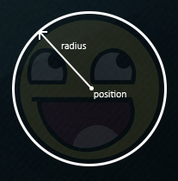
AABB - Circle collision detection
It makes much more sense to represent the ball with a circle collision shape instead of an AABB. For this reason we included a Radius variable within the ball object. To define a circle collision shape all we need is a position vector and a radius.

Slide 41
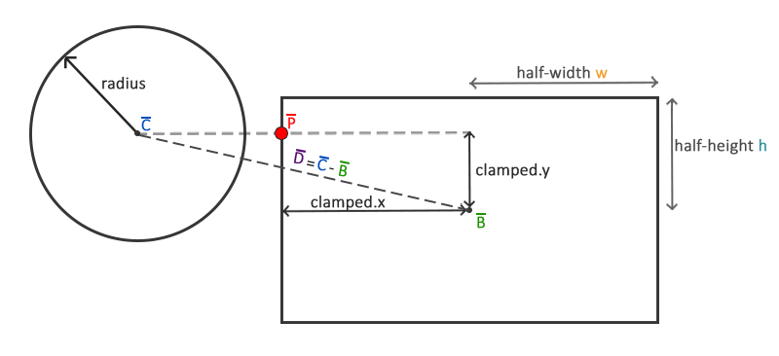
AABB - Circle collision detection
This does mean we have to update the detection algorithm since it currently only works between two AABBs. Detecting collisions between a circle and a rectangle is slightly more complicated, but the trick is as follows: we find the point on the AABB that is closest to the circle and if the distance from the circle to this point is less than its radius, we have a collision.
The difficult part is getting this closest point P¯ on the AABB. The following image shows how we can calculate this point for any arbitrary AABB and circle:

Slide 42
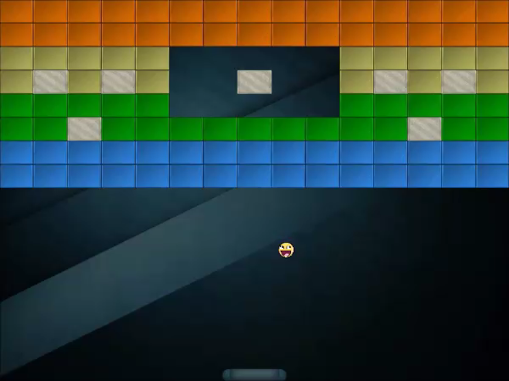
how do we determine collisions?
Notes:
Circle&circle collision
take your pick.
//#define twod_collision 0
/* or */
//#define threed_collision 0
bool detectcollision(int x1, int y1, int z1,int radis1, int x2, int y2, int z2, int radis2)
{
int xd, yd, zd, Distance;
//2d
#ifdef twod_collision
xd = x2-x1;
yd = y2-y1;
Distance = SquareRoot(xd*xd + yd*yd)
#endif
//3d
#ifdef threed_collision
xd = x2-x1;
yd = y2-y1;
zd = z2-z1;
Distance = SquareRoot(xd*xd + yd*yd + zd*zd);
#endif
if( radis1 + radis2 >= Distance)
return true; //collision
return false; //no collision
}

Slide 43
Example
Notes:
https://learnopengl.com/Getting-started/Textures

Slide 44
Links
https://learnopengl.com/
http://www.videotutorialsrock.com/
https://www.ntu.edu.sg/home/ehchua/programming/opengl/CG_Introduction.html
https://www.coders-hub.com/2013/06/opengl-code-for-collision-detection.html#.WttVyIhubIV
https://hackr.io/tutorials/learn-opengl
https://open.gl/
https://www.opengl.org/resources/libraries/glut/

Slide 45
Thanks ☺

